Slide 1
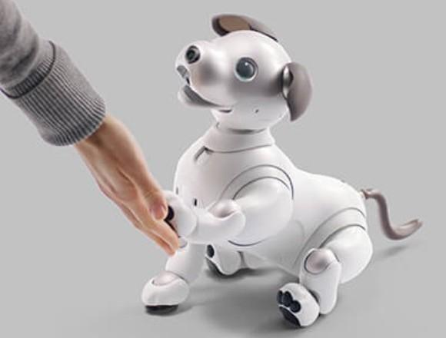
Case Analysis: Sony Corporation
November 9, 2018
Orange Team: Minh Truong Nguyen, Clark Jason Ngo, Jasveer Kaur
Nailia Gibadullina, Tuan Khai Tran, Yang (Cecilia) Li

Slide 2


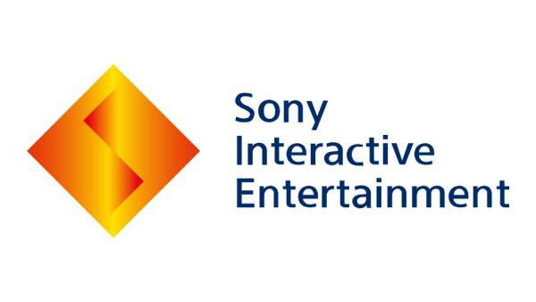


Sony’s Portfolio
Founded in 1946
Go Global in the 1950s
Entered the US in 1960
Branched into various markets
Notes:
Initially working as a producer of electronic product. Sony soon branched out into various markets such as gaming, Movie, Music, Healthcare, Financial Service and even Insurance.

Slide 3
Aibo
Launched in 1999
Discontinued in 2006
Revived in 2017
Notes:
In 1999 Took the first step in entering the AI market with the launch of Aibo
However, in 2005, Sony experienced structural challenges as the company became too large and diverse, management became fragmented. The company suffered from certain market forces that affected its ability to compete. With the aim to generate profit, CEO Howard Stringer decided to discontinue the production.

Slide 4
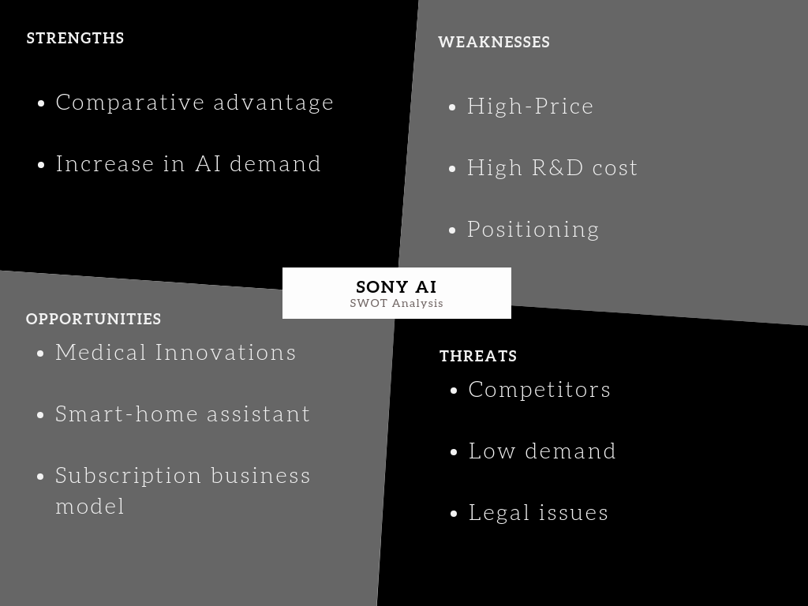
SWOT

Slide 5
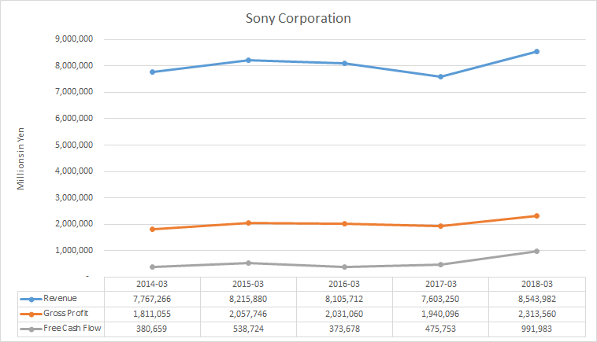
Sony Corporation - Financials
Notes:
5-Year average for Revenues: 4.67%
5-Year average for Gross Profit: 231.33 %

Slide 6
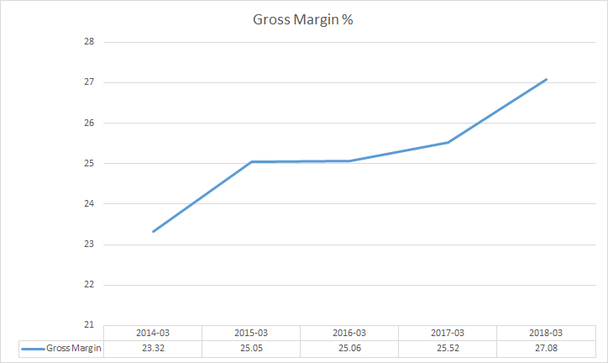
Sony Corporation - Financials

Slide 7
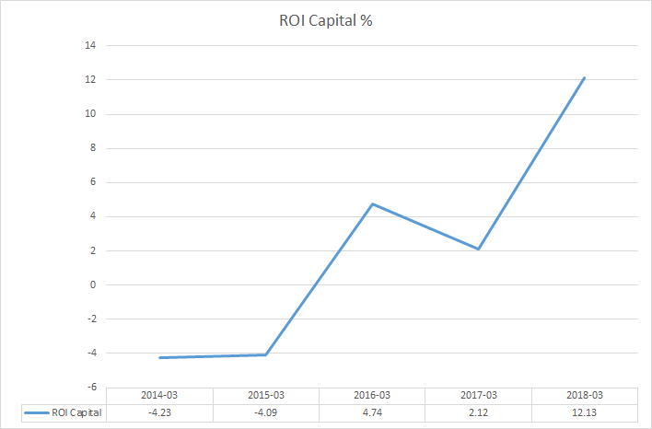
Sony Corporation - Financials

Slide 8
Risk Analysis
Internal:
Management Risk
External:
Customer Acceptance
Tax Reform Impact
Notes:
1. Customer acceptance
The research showed that “when asked about their opinion of developing of robot caregivers for older adults, about 47% of American adults were worried about that, whereas 44% percent were enthusiastic (Pew Research Center).
2. Tax reform impact
“American companies currently attribute about $2.8 trillion to their overseas units. The new law requires them to bring the money back to the United States — or to “repatriate” it — but at reduced tax rates as low as 8 percent ” (The New York Times).

Slide 9
Risk Control
Avoid & Reduce Accept (Improve) Transfer
Management Risk
Tax Reform Impact
Customer Acceptance
Notes:
Risk controls:
Improve customers’ acceptance: Open the “black box”, be more transparent about how robot dog works. Increasing transparency about the government requests and supervision disclosures could build a trust between Sony and its customers, as well as helping them to build a better understanding of AIBO (“People Don't Trust AI--Here's How We Can Change That”).
Tax reform impact: consult with tax professionals; do more additional tax research and planning.
Management risk control: According to Sony’s official website, each Sony Group business unit and corporation division is expected to review and assess business risks and to detect, communicate, evaluate and respond to risk on a regular basis.

Slide 10


Legal Analysis
Data Protection
The U.S. market has high concerns for privacy
Make use of the GDPR
Competitive Advantages

Slide 11


Focus on Medical Diagnosis as a Solution

Slide 12
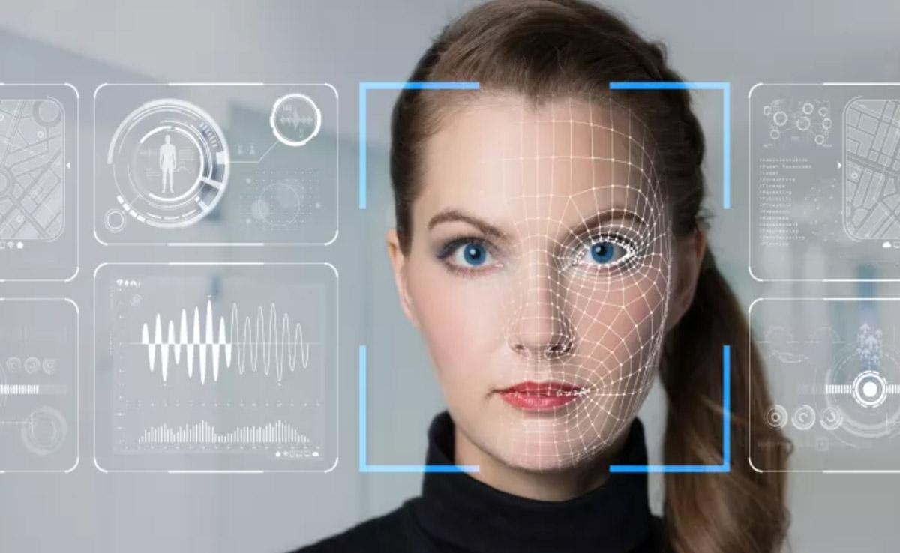
How the Data is Collected?
Sensors
Camera Technology
Speech & Voice Analysis
Scanning Technology

Slide 13

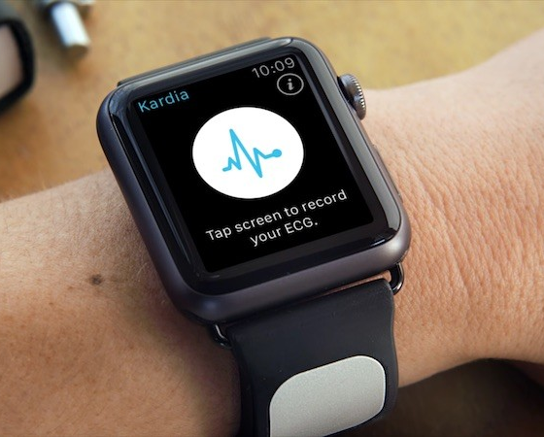
AI in Medicine
Chatbots
Apple Watch

Slide 14

AI in Medicine
IBM speech & voice analysis to detect mental illnesses

Slide 15

Statistics
50% increase in the use of robotics for medical and healthcare delivery services by 2019
(IDC’s Worldwide Healthcare IT 2017 Predictions)

Slide 16
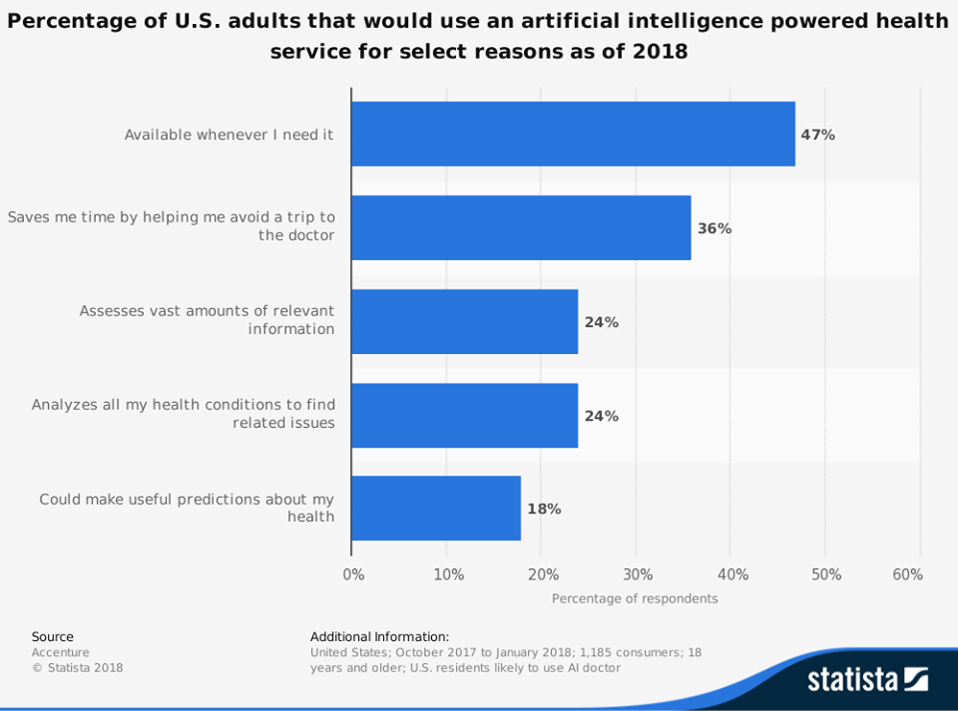
Statistics

Slide 17

Positioning Value
New healthcare experience
Time and resource efficiency
Reduced healthcare cost
Early detection of mental illnesses and medical conditions
Provide more data for the medical researches

Slide 18

Q&A
Any questions or concerns?
Thanks for your attention!

Slide 19
References
Jessica, L. 2017. Artificial intelligence in healthcare – the regulatory environment (Part two of a four part series). Todd, A. Retrieved from: https://www.healthcapital.com/hcc/newsletter/05_17/PDF/AI.pdf
Norwegian Data Protection Authority, 2018. Artificial intelligence and privacy. Datatilsynet. Retrieved from: https://iapp.org/media/pdf/resource_center/ai-and-privacy.pdf
People Don't Trust AI--Here's How We Can Change That. Retried from
https://www.scientificamerican.com/article/people-dont-trust-ai-heres-how-we-can-change-that/
Pew Research Center. (n.d.). American adults' attitudes towards different aspects of automation in 2017. In Statista - The Statistics Portal. Retrieved November 8, 2018, from https://www-statista-com.proxy.cityu.edu/statistics/780310/us-adults-attitude-towards-automation/.
The New York Times. Companies Warn of Hits From Tax Cuts. Don’t Be Fooled. Retried from https://www.nytimes.com/2018/01/04/business/corporate-tax-cuts.html
Sony. (n.d.). Sony's research and development (R&D) expenses 2011-2017 (in billion Japanese yen/billion U.S. dollars). In Statista - The Statistics Portal. Retrieved November 7, 2018, from https://www.statista.com/statistics/739101/sony-research-and-development-expenses/.

